Slide 1


Slide 2

CSS pseudo-classes are used to add special effects to some selectors
What is a pseudo-class?
A pseudo-class allows you to take into account different conditions or events when defining a property for an HTML tag.
The syntax of pseudo-classes:
selector:pseudo-class {property: value;}
CSS classes can also be used with pseudo-classes:
selector.class:pseudo-class {property:value;}

Slide 3

EX: links are specified in HTML with <a> tags. We can therefore use a as a selector in CSS:
    a {
    color: blue;
    }
You can use pseudo-classes to assign different styles to visited and unvisited links.
  a:link {
  color: blue;
  }
  a:visited {
  color: red;
  }

Slide 4

The pseudo-class :link is used for links leading to pages that the user has not visited.
The pseudo-class :visited is used for links leading to pages that the user has visited.
The pseudo-class :active is used for links that are active.
The pseudo-class :hover is used when the mouse pointer hovers over a link.

Slide 5

Pseudo-classes and CSS Classes
If the link in the example above has been visited, it will be displayed in red.
a.red:visited {color:#FF0000;}
< a class="red" href="css_syntax.asp">CSS Syntax</a>
CSS - The :first-child Pseudo-class
The :first-child matches an element that is the first child of another element.
Match the first <p> element
In this example, the selector matches any <p> element that is the first child of any element:
Example

Slide 6
Match the first <i> element in all <p> elements
Example
< html>
< head>
< style>
p > i:first-child{color:blue;}
< /style>
< /head>
< body>
< p>I am a <i>strong</i> man. I am a <i>strong</i> man.</p>
< p>I am a <i>strong</i> man. I am a <i>strong</i> man.</p>
< /body>
< /html>

Slide 7
Match all <i> elements in all first child <p> elements
In the example, the selector matches all <i> elements in <p> elements that are the first child of another element:
Example
< html>
< head>
< style>
p:first-child i {color:blue;}
< /style>
< /head>
< body>
< p>I am a <i>strong</i> man. I am a <i>strong</i> man.</p>
< p>I am a <i>strong</i> man. I am a <i>strong</i> man.</p>
< /body>
< /html>

Slide 8

The elements <span> and <div> are used to group and structure a document and will often be used together with the attributes class and id.
The <span> tag has no visual effect on its contents.
<SPAN ...> is a text-level element.
with CSS, <span> can be used to add visual features to specific parts of text in your documents.
It should only be used to set text within a paragraph.
EX

Slide 9

<div> is used to group one or more block-level elements.
The only effect of the <div> tag is to block off its contents, similar to putting a <br> tag before and after a section on the page.
EX

Slide 10

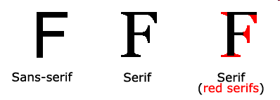
CSS font properties define the font family, boldness, size, and the style of a text.
Difference Between Serif and Sans-serif Fonts
On computer screens, sans-serif fonts are considered easier to read than serif fonts.

Slide 11

The property font-family is used to set a prioritized list of fonts to be used to display a given element or web page.
If the first font on the list is not installed on the computer used to access the site, the next font on the list will be tried until a suitable font is found.
There are two types of names used to categorize fonts: family-names and generic families.
Examples of a family-name : "Arial", "Times New Roman" or "Tahoma".
Generic families can best be described as groups of family-names with uniformed appearances. An example is sans-serif.
EX:
  h1 {font-family: arial, Tahoma, sans-serif;}
  h2 {font-family: "Times New Roman", serif;}

Slide 12

The font-style property has three values:
  normal - The text is shown normally
  italic - The text is shown in italics
  oblique - The text is "leaning" (oblique is very similar to italic, but less supported)
EX.
  p.normal {font-style:normal;}
  p.italic {font-style:italic;}
  p.oblique {font-style:oblique;}

Slide 13

The font-size property sets the size of the text.
The font-size value can be an absolute, or relative size.
Absolute size:
  Sets the text to a specified size
  Does not allow a user to change the text size in all browsers (bad for accessibility reasons).
  Absolute size is useful when the physical size of the output is known.
Relative size:
  Sets the size relative to surrounding elements.
  Allows a user to change the text size in browsers.

Slide 14

CSS allows you to specify font size, border size, margins, padding, etc. using many different units of measurement.
A decimal number followed by an absolute unit:
  a relative unit:
  em (1em = size of the letter "M" in current font)
  ex (1ex = height of letter 'x' in current font)
  The em size unit is recommended by the W3C.
  The default text size in browsers is 16px= 1em
mm (Millimeter) | Pt (Point, 1pt = 1/72 in)
cm (Centimeter, 1cm = 10mm) | Pc (Pica, 1pc = 12pt)
In (Inch, 1in = 2.54cm) | Percentage or the pixel unit: px A decimal number followed by a % symbol.

Slide 15

The property font-variant is used to choose between normal or small-caps variants of a font.
small-caps
all lowercase letters are converted to uppercase letters.
but, the converted uppercase letters appears in a smaller font size
Property Values | Description
normal | The browser displays a normal font. This is default
small-caps | The browser displays a small-caps font
inherit | Specifies that the font variant should be inherited from the parent element

Slide 16

Value | Description
normal | Defines normal characters. This is default
bold | Defines thick characters
bolder | Defines thicker characters
lighter | Defines lighter characters
100 , 200 , 300, 400 ,…,900 | Defines from thin to thick characters. 400 is the same as normal, and 700 is the same as bold

Slide 17

The order of values for font is:
font-style | font-variant | font-weight | font-size | font-family
EX:
  p {
  font-style: italic;
  font-weight: bold;
  font-size: 30px;
  font-family: arial, sans-serif;
  }
  using the short hand property, the code can be simplified:
  p {
  font: italic bold 30px arial, sans-serif;
  }

Slide 18

The following CSS Text properties will be described:
  text-indent
  text-align
  text-decoration
  letter-spacing
  text-transform

Slide 19

The property text-indent allows you to add an elegant touch to text paragraphs by applying an indent to the first line of the paragraph.
In the example below a 30px is applied to all text paragraphs marked with <p>:
  p {
  text-indent: 30px;
  }

Slide 20

The text-align property is used to set the horizontal alignment of a text.
Text can be centered, or aligned to the left or right, or justified.
When text-align is set to "justify", each line is stretched so that every line has equal width, and the left and right margins are straight
Ex:
  h1 {text-align:center;}
  p.date {text-align:right;}
  p.main {text-align:justify;}

Slide 21

The text-decoration property is used to set or remove decorations from text.
The text-decoration property is mostly used to remove underlines from links for design purposes:
Ex:
a {text-decoration:none;}

Slide 22

Value | Description
none | Defines a normal text. This is default
underline | Defines a line below the text
overline | Defines a line above the text
line-through | Defines a line through the text
inherit | Specifies that the value of the text-decoration property should be inherited from the parent element

Slide 23

The letter-spacing property increases or decreases the space between characters in a text.
Value | Description
normal | No extra space between characters. This is default
length | Defines an extra space between characters (negative values are allowed)
inherit | Specifies that the value of the letter-spacing property should be inherited from the parent element

Slide 24

The text-transform property controls the capitalization of text.
Value | Description
none | No capitalization. The text renders as it is. This is default
capitalize | Transforms the first character of each word to uppercase
uppercase | Transforms all characters to uppercase
lowercase | Transforms all characters to lowercase
inherit | Specifies that the value of the text-transform property should be inherited from the parent element

Slide 25

The text-overflow property specifies what should happen when text overflows the containing element.
Ex:
Value | Description
clip | Clips the text
ellipsis | Render an ellipsis ("...") to represent clipped text
string | Render the given string to represent clipped text

Slide 26

The CSS box model is essentially a box that wraps around HTML elements, and it consists of: margins, borders, padding, and the actual content.
The box model allows us to place a border around elements and space elements in relation to other elements.

Slide 27

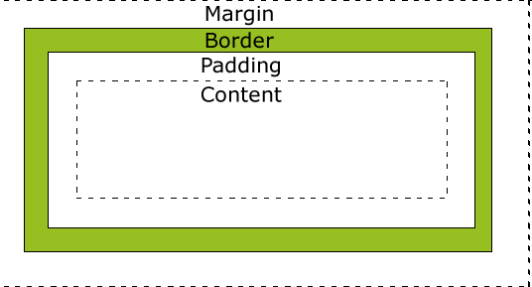

Slide 28

The margin clears an area around an element (outside the border).
The margin does not have a background color, and is completely transparent.
The top, right, bottom, and left margin can be changed independently using separate properties.
Possible Values
Value | Description
auto | The browser sets the margin. The result of this is dependant of the browser
length | Defines a fixed margin (in pixels, pt, em, etc.)
% | Defines a margin in % of the containing element

Slide 29

Property | Description | Values
margin | A shorthand property for setting the margin properties in one declaration | margin-top margin-right margin-bottom margin-left
margin-bottom | Sets the bottom margin of an element | auto length %
margin-left | Sets the left margin of an element | auto length %
margin-right | Sets the right margin of an element | auto length %
margin-top | Sets the top margin of an element | auto length %

Slide 30

A shorthand margin property can also be used, to change all margins at once.
Value | Description
margin:25px 50px 75px 100px; | top margin is 25px right margin is 50px bottom margin is 75px left margin is 100px
margin:25px 50px 75px; | top margin is 25px right and left margins are 50px bottom margin is 75px
margin:25px 50px; | top and bottom margins are 25px right and left margins are 50px
margin:25px; | all four margins are 25px

Slide 31

The CSS border properties allow you to specify the style and color of an element's border.
Borders can be used for many things, for example as a decorative element or to underline a separation of two things.
CSS gives you endless options when using borders in your pages.

Slide 32

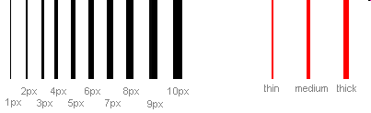
The width of borders is defined by the property border-width, which can obtain the values thin, medium, and thick, or a numeric value, indicated in pixels. The figure below illustrates the system:

Slide 33
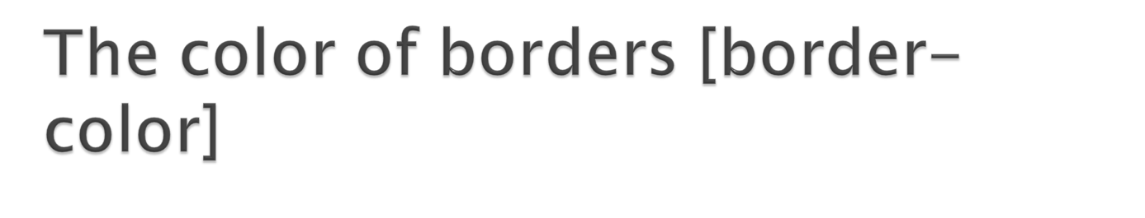
The property border-color defines which color the border has.
The values are the normal color-values for example "#123456", "rgb(123,123,123)" or "yellow" .

Slide 34
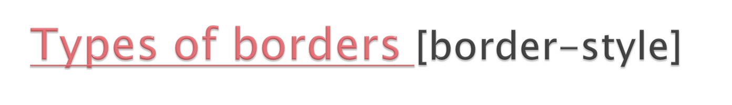
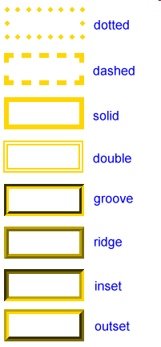
The border-style property specifies what kind of border to display.
none: Defines no border
dotted: Defines a dotted border
dashed: Defines a dashed border
solid: Defines a solid border
double: Defines two borders. The width of the two borders are the same as the border-width value
groove: Defines a 3D grooved border. The effect depends on the border-color value
ridge: Defines a 3D ridged border. The effect depends on the border-color value
inset: Defines a 3D inset border. The effect depends on the border-color value
outset: Defines a 3D outset border. The effect depends on the border-color value

Slide 35

As it is also the case for many other properties, you can compile many properties into one using border. Let us take a look at an example:
  p {
  border-width: 1px;
  border-style: solid;
  border-color: blue;
  }
  Can be compiled into:
  p {
  border: 1px solid blue;
  }

Slide 36

The padding clears an area around the content (inside the border) of an element. The padding is affected by the background color of the element.
Property | Description | Values
Padding | A shorthand property for setting all the padding properties in one declaration | padding-top padding-right padding-bottom padding-left
padding-bottom | Sets the bottom padding of an element | length %
padding-left | Sets the left padding of an element | length %
padding-right | Sets the right padding of an element | Length %
padding-top | Sets the top padding of an element | length %

Slide 37

With CSS float, an element can be pushed to the left or right, allowing other elements to wrap around it.
Float is very often used for images
property | Description | Values
clear | Specifies which sides of an element where other floating elements are not allowed | left right both none inherit
float | Specifies whether or not a box should float | Left right none inherit

